Slide 1

SQL COMMANDS

Slide 2
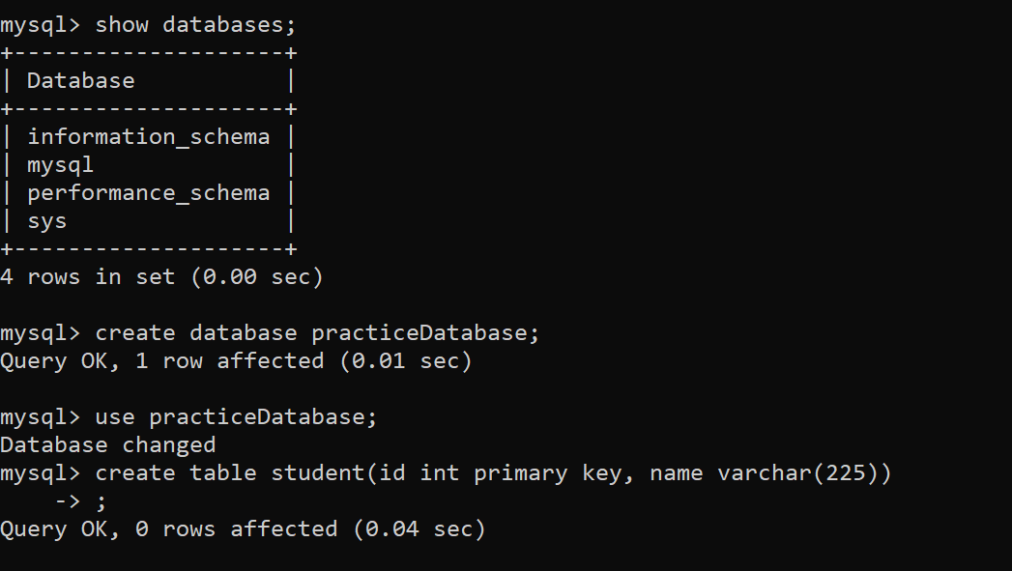

Slide 3
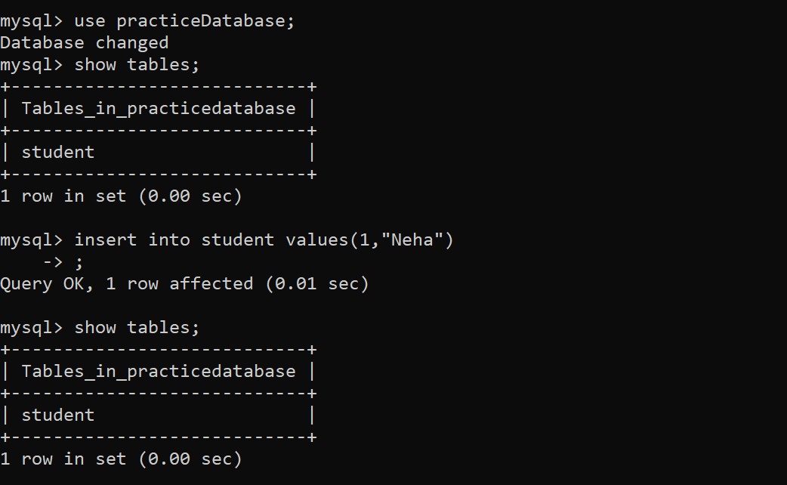

Slide 4
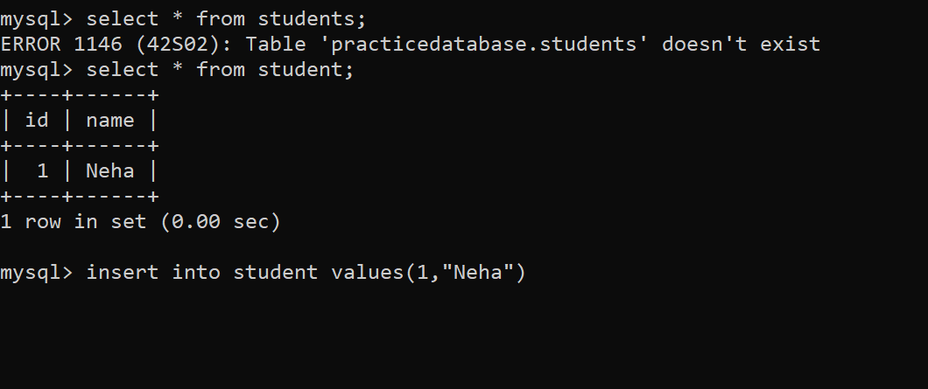
The columns in a table are called fields while the rows can be referred to as records.

Slide 5
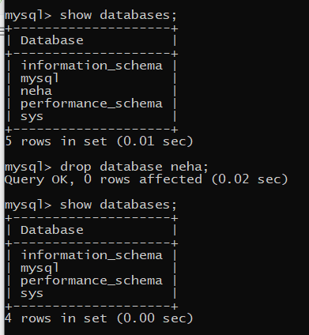

Slide 6
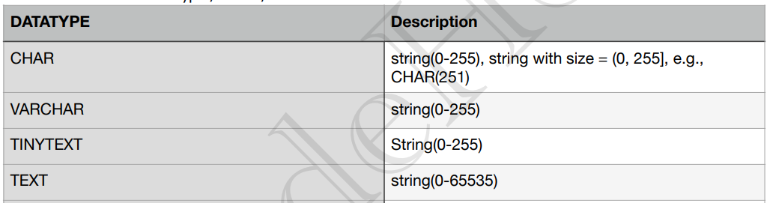
Data type: to store data in which form
Char : fixed size eg: array in java of fixed size
Varchar : variable size eg: arrayList in java (according to need :space efficient approach)
Text : similar to varchar but with more space .

Slide 7
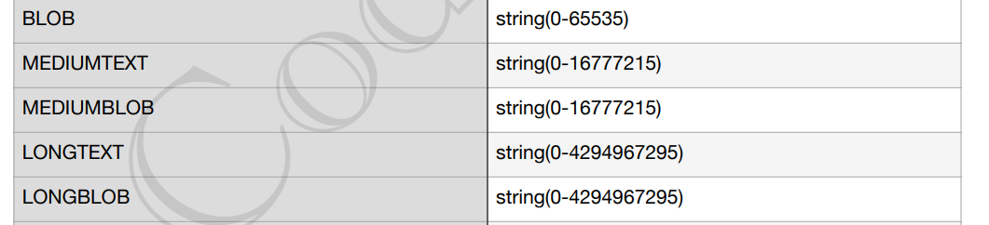
Any type of file being stored in bits format is the most efficient way of storing data if we don’t have any cloud service for storing data.
BLOB : bulky file

Slide 8
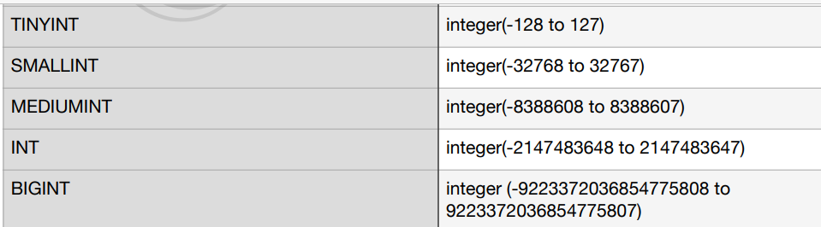
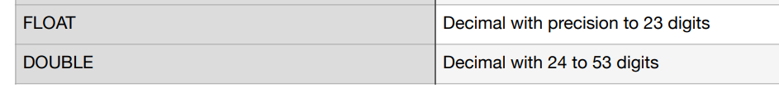
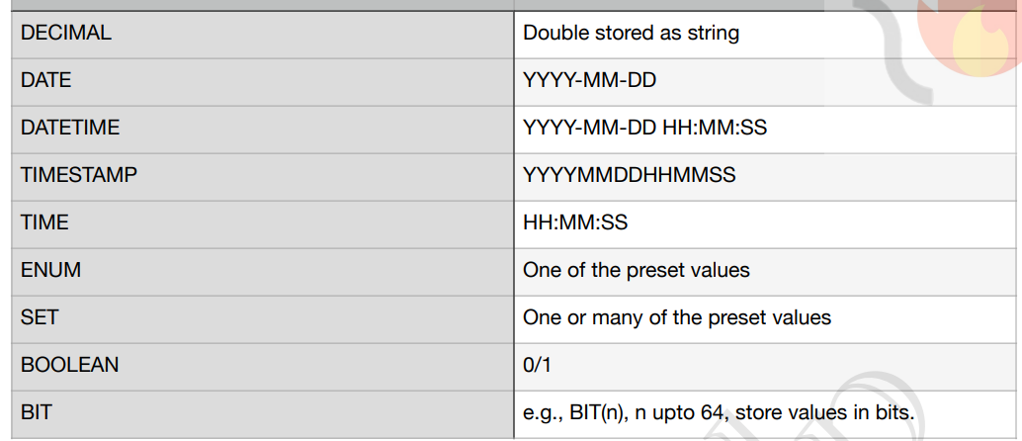

Slide 9
A set of values
Enum : one value at a time
Set : set of values can be assigned at a time .
**Values can also be unsigned e.g., INT UNSIGNED.
JSON : key value pair of data . As a object

Slide 10
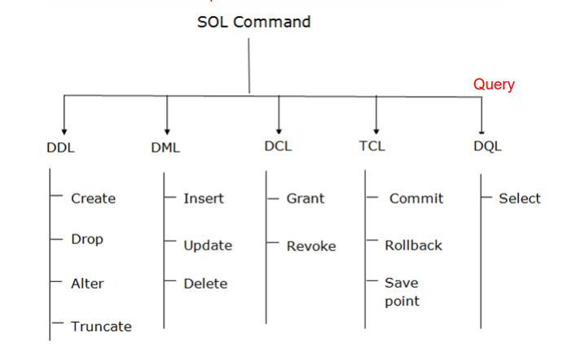
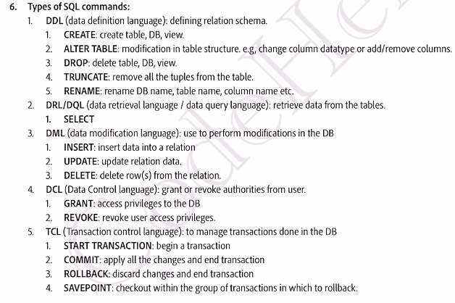

Slide 11
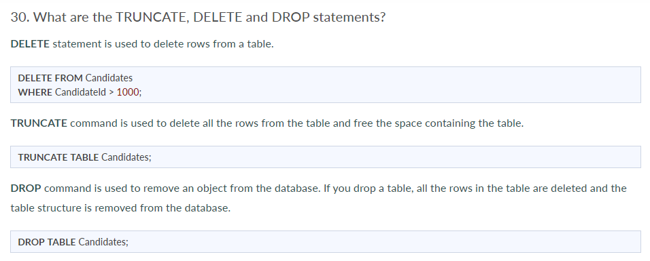

Slide 12
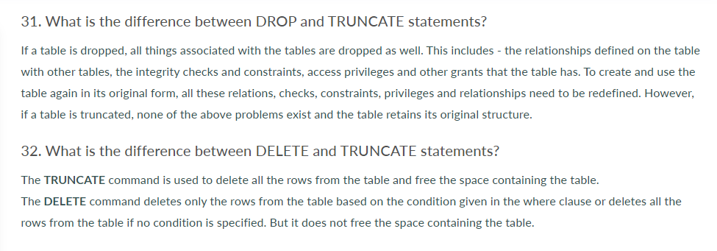

Slide 13
Transaction
Set of actions/task
performed to access and modify the contents of the database as per the user’s request.

Slide 14
Q.4: What is meant by schedules of transactions in DBMS?
When multiple transaction requests are made at the same time, we need to decide the order of execution of these transactions.
This chronological order of execution of transactions is called as a schedule of transactions in DBMS.
It is mainly of two types, i.e. Serial Schedules and Non Serial Schedules.

Slide 15
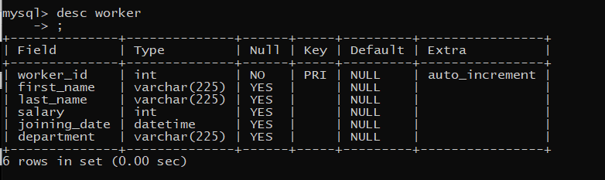
create table worker(worker_id int primary key auto_increment , first_name varchar(225),last_name varchar(225), salary int , joining_date datetime , department varchar(225))

Slide 16
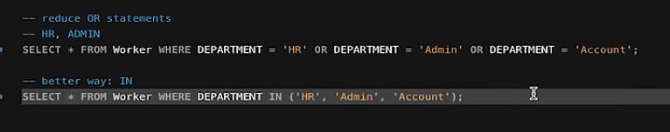
Logical operator :
AND
OR
NOT

Slide 17
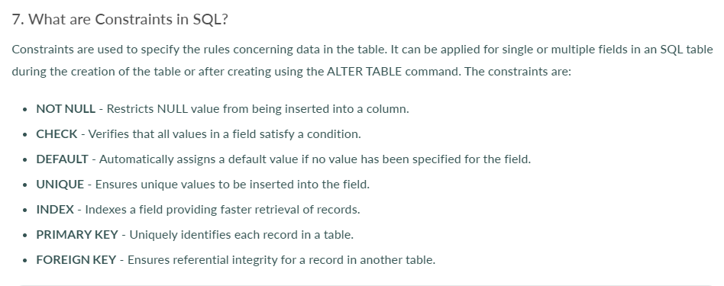

Slide 18
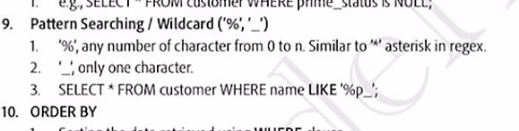
REGEX

Slide 20
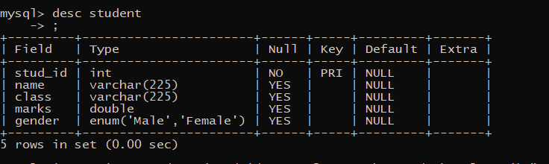
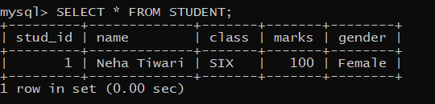
create table student (stud_id int primary key , name varchar(225),class varchar(225),marks double , gender enum ('Male','Female') );
insert into student (stud_id,name,class,marks,gender) values (1,"Neha Tiwari","SIX",100,"FEMALE");
** NOTE : MYSQL is not case sensitive

Slide 21
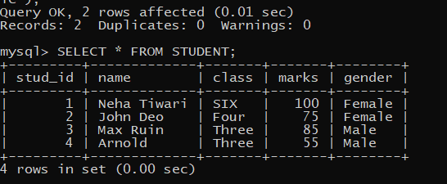
Insert query remains same for one insertion of data or multiple
Eg :
insert into student (stud_id,name,class,marks,gender) values (2, 'John Deo', 'Four', 75, 'female');
insert into student (stud_id,name,class,marks,gender) values (3, 'Max Ruin', 'Three', 85, 'male'),(4,'Arnold', 'Three', 55, 'male');

Slide 22
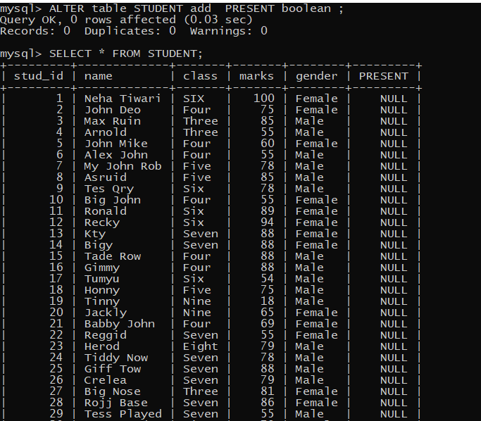
ALTER TABLE STUDENT ADD PRESENT BOOLEAN ;

Slide 23
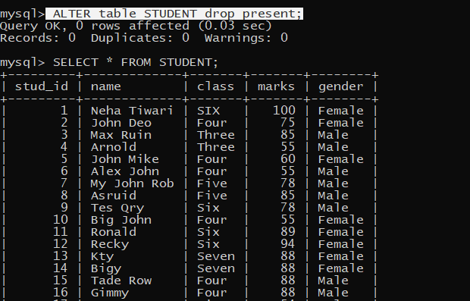

Slide 24
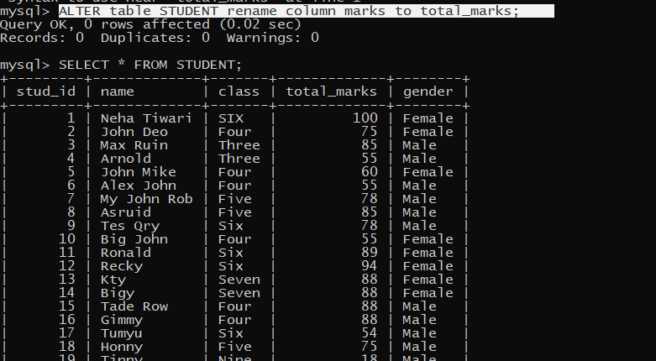

Slide 25
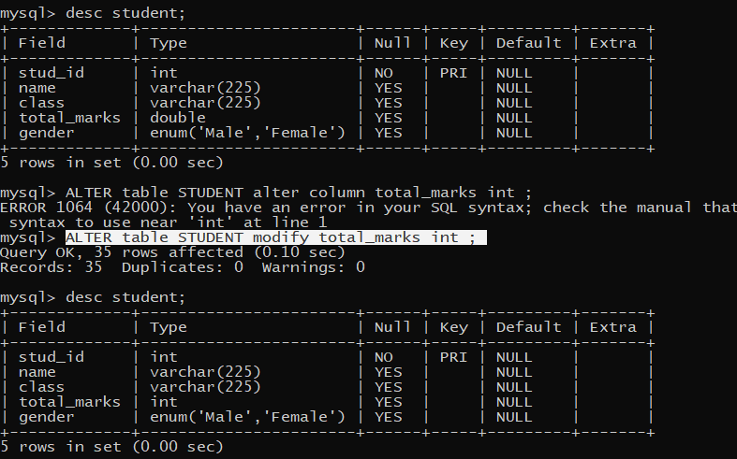

Slide 26
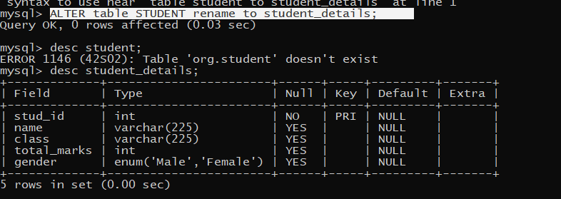

Slide 27
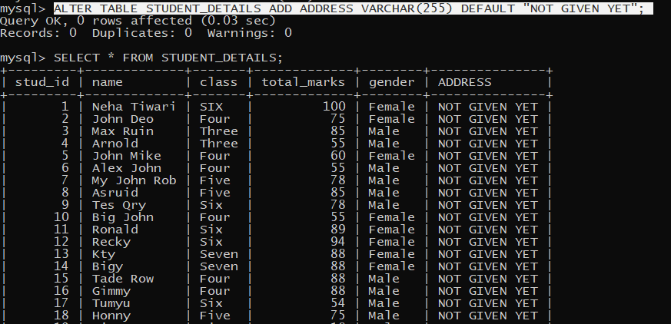

Slide 28
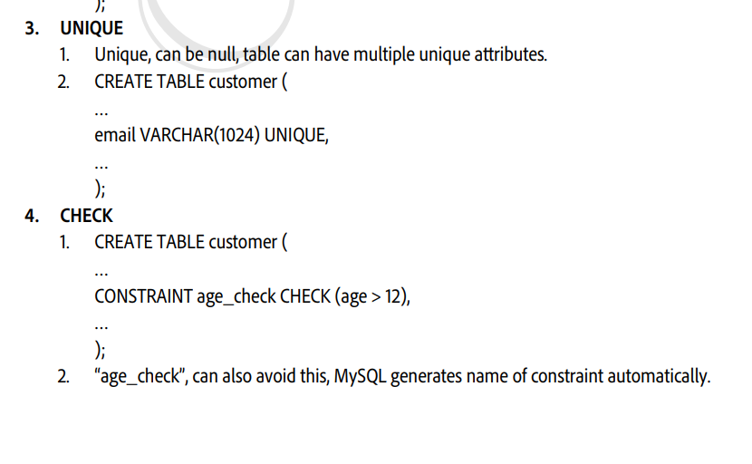
VALIDATION

Slide 29
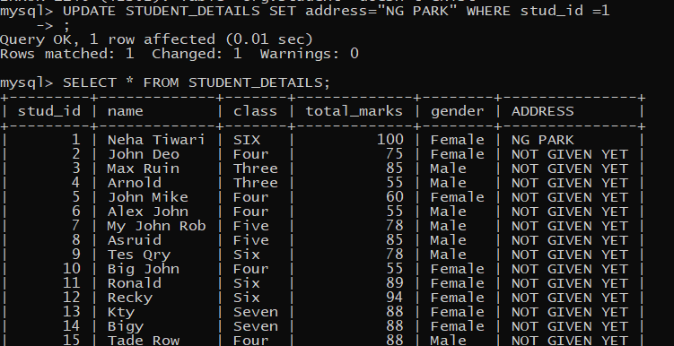

Slide 30
DELETE FROM STUDENT_DETAILS WHERE STUD_ID IN (34,35);
Query OK, 2 rows affected (0.01 sec)

Slide 31
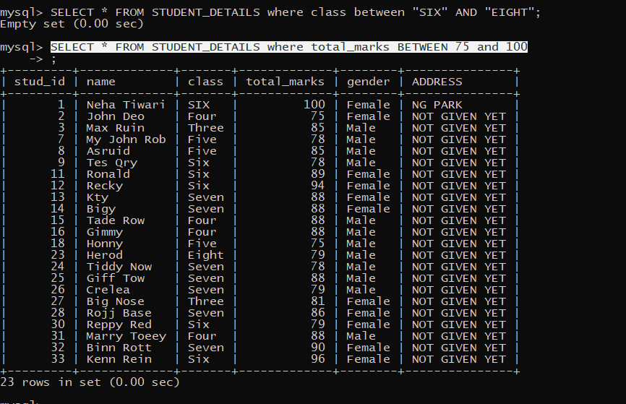
BETWEEN : ONLY WITH NUMBERS AND INCLUSIVE IN NUMBERS;

Slide 32
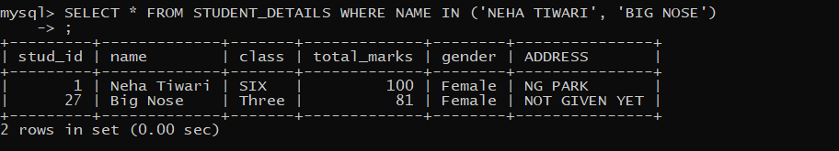
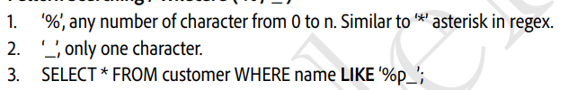
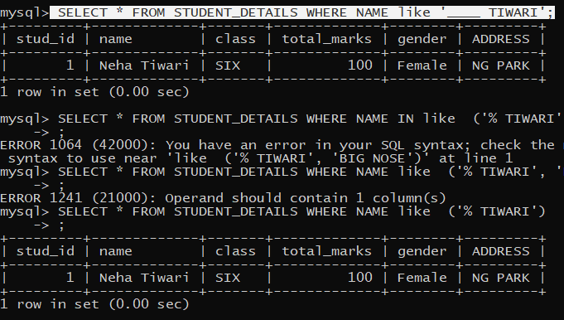
IN : to provide a list of data to filter it out from the whole table (OR gate internally)
LIKE

Slide 33
ORDER BY : FOR SORTING (applicable for all columns )
(2 mode : ASC AND DESC)
SELECT * FROM STUDENT_DETAILS ORDER BY CLASS ASC;

Slide 34
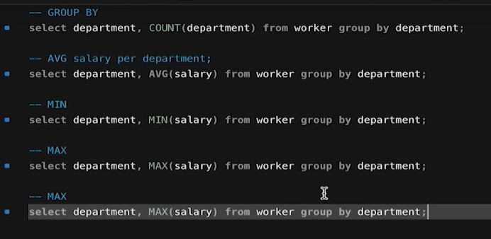
Group by is used as an aggregate function where mostly we need distinct records based on specific field/s.
Some rules need to be followed :
Same column_name should be mentioned column_name after GROUP BY and SELECT
It gives more impact when used with aggregate methods: COUNT , SUM ,AVG , MIN AND MAX on any of the field .

Slide 35
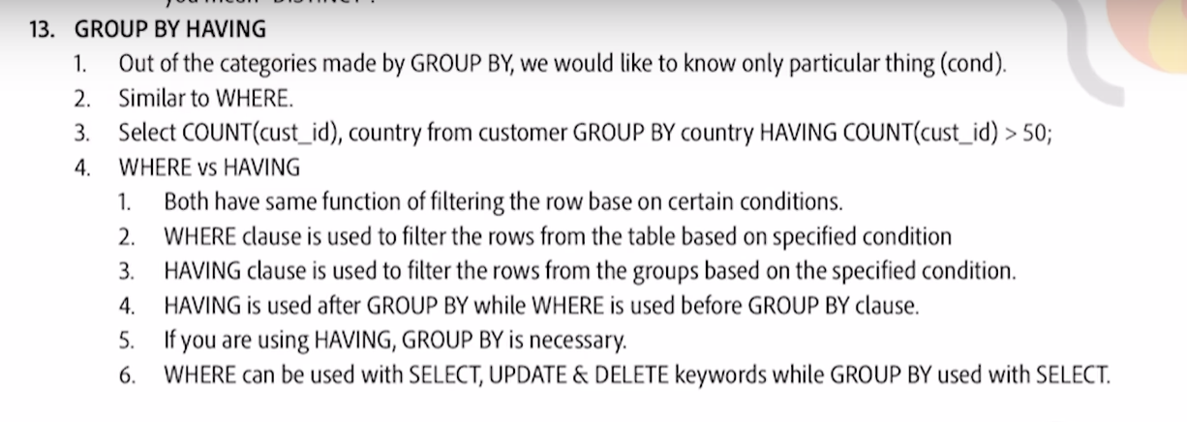



Slide 36
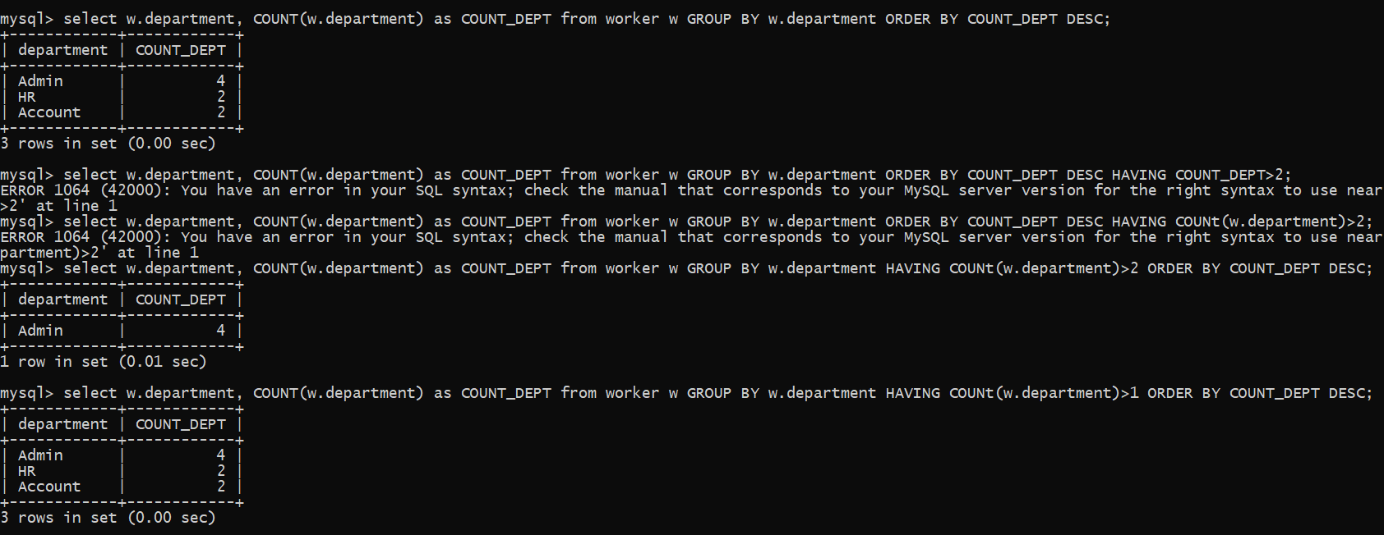


select w.department, COUNT(w.department) as COUNT_DEPT from worker w GROUP BY w.department HAVING COUNt(w.department)>1 ORDER BY COUNT_DEPT DESC;
select w.department, COUNT(w.department) as COUNT_DEPT from worker w GROUP BY w.department ORDER BY COUNT_DEPT DESC HAVING COUNt(w.department)>2;

Slide 37
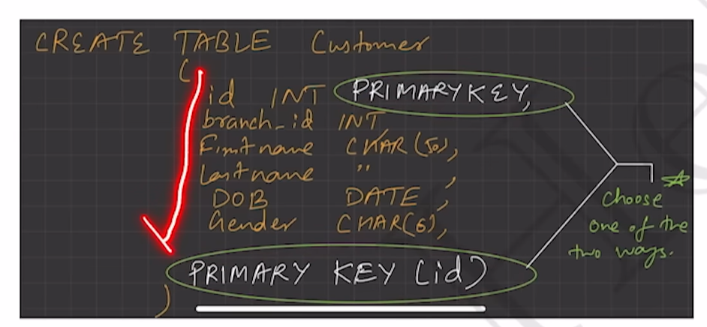
PRIMARY KEY CONSTRAINTS :
NOT NULL
UNIQUE
ONLY ONE PK PER TABLE
MOSTLY KEEP IT INTEGER

Slide 38
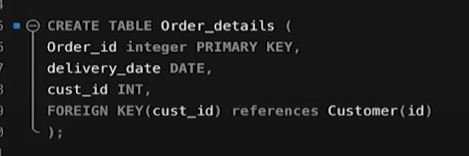
FOREIGN KEY CONSTRAINTS :
PRIMARY KEY OF ANOTHER TABLE (REFERENCE)
REFERENCES KEYWORD IS USED WHILE MAKING TABLE RELATIONS
MAKE FK PER TABLE
MOSTLY KEEP IT INTEGER as Primary key
Table to be created
Table referring to with it’s primary key

Slide 39
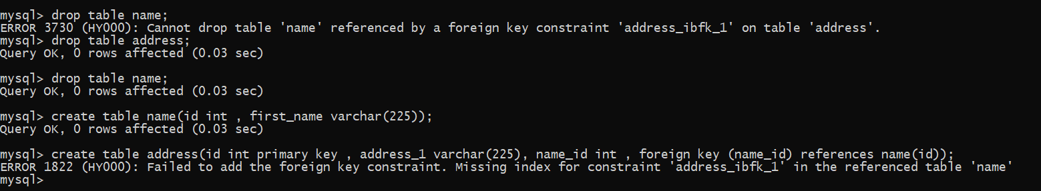
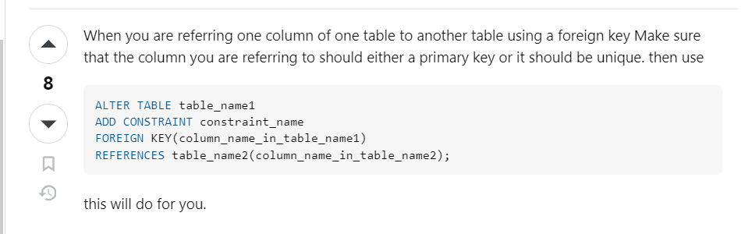


Fk key should be pk in its table ?
Yes, it’s necessary to be primary key or unique constraints else it will not get created.

Slide 40
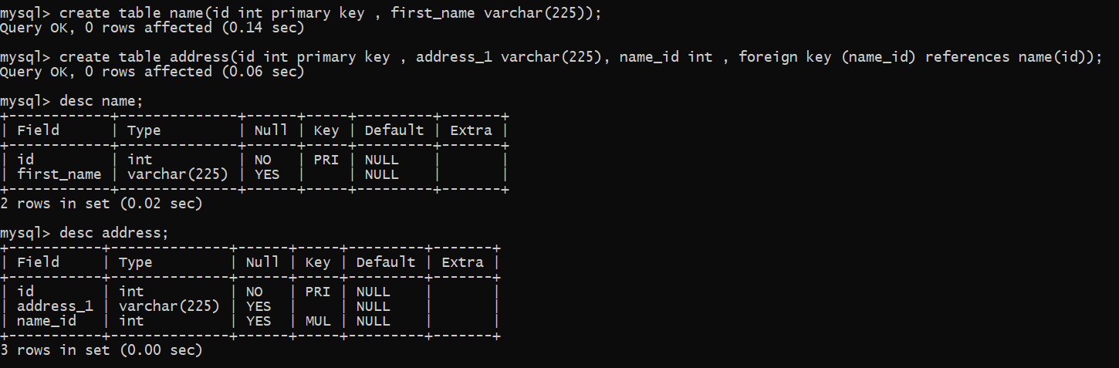
CORRECT WAY

Slide 41
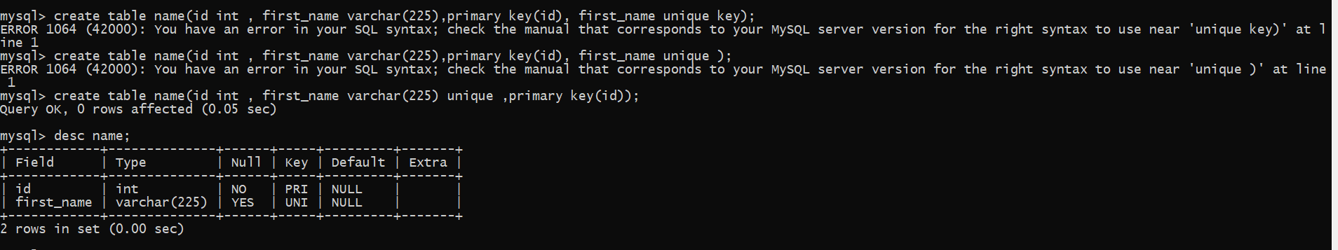

UNIQUE KEY
It is to make a particular field with a unique set only things only .
Eg : In the product table, we only want the first name should be unique in a table of products, if the same name is repeated while insertion it will throw an exception.
create table name(id int , first_name varchar(225) unique ,primary key(id));

Slide 42
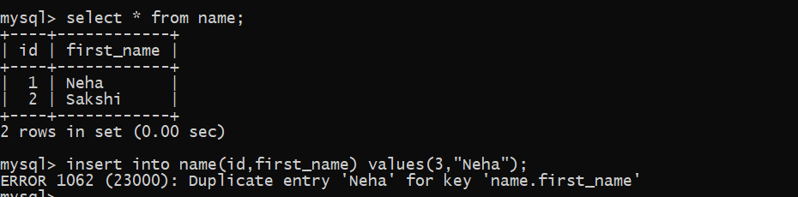


Slide 43
CHECK
This is a keyword to check whether a provided condition is satisfied while insertion or updating of a record.

Slide 44
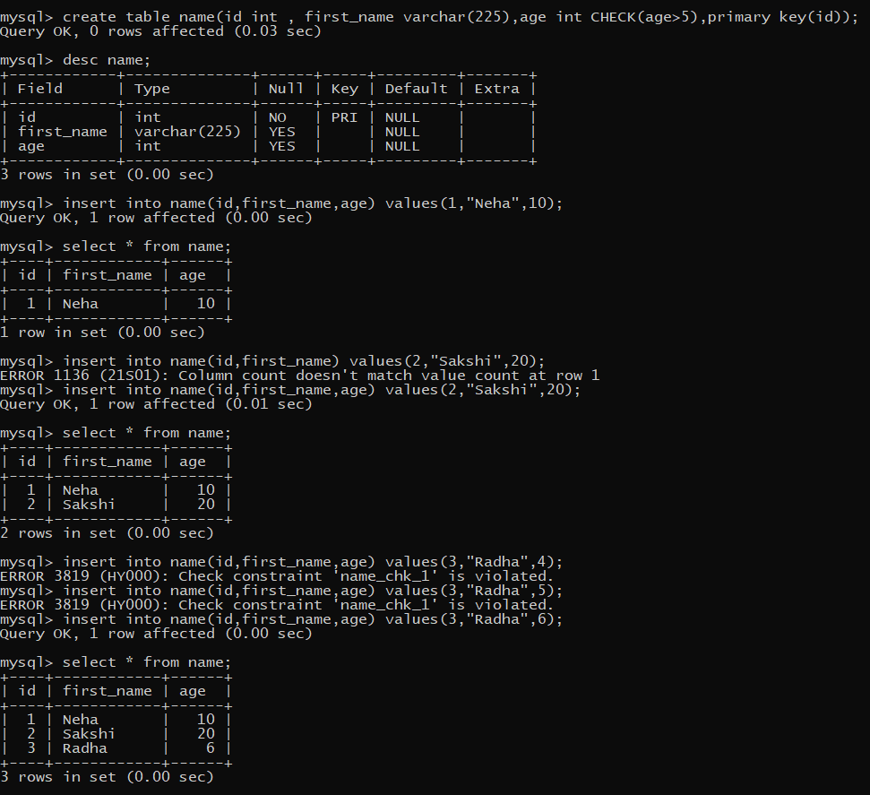

Slide 45
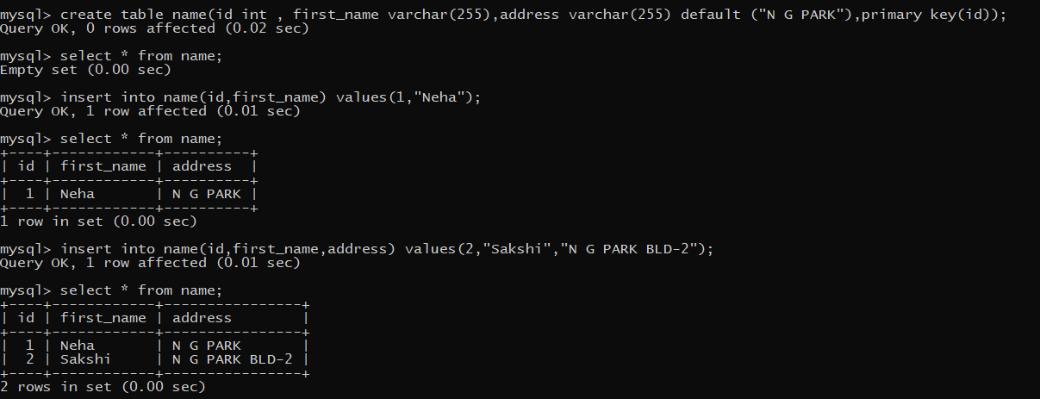
DEFAULT
This is a keyword to give a default value on insertion if not provided.

Slide 46
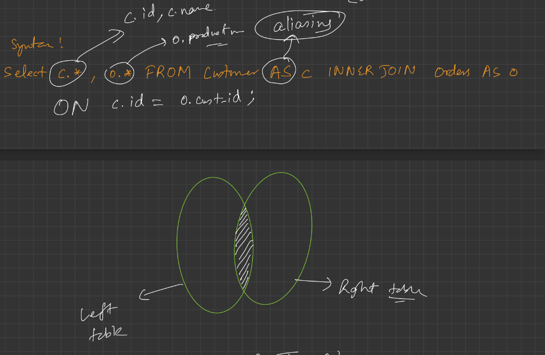
JOINS
When we have two tables in some relation by using FK.
By using these tables how can we fetch data is called JOINS.
To apply join there must be a common attribute in both the tables.
1. INNER JOIN: all matching records from both the tables

Slide 47
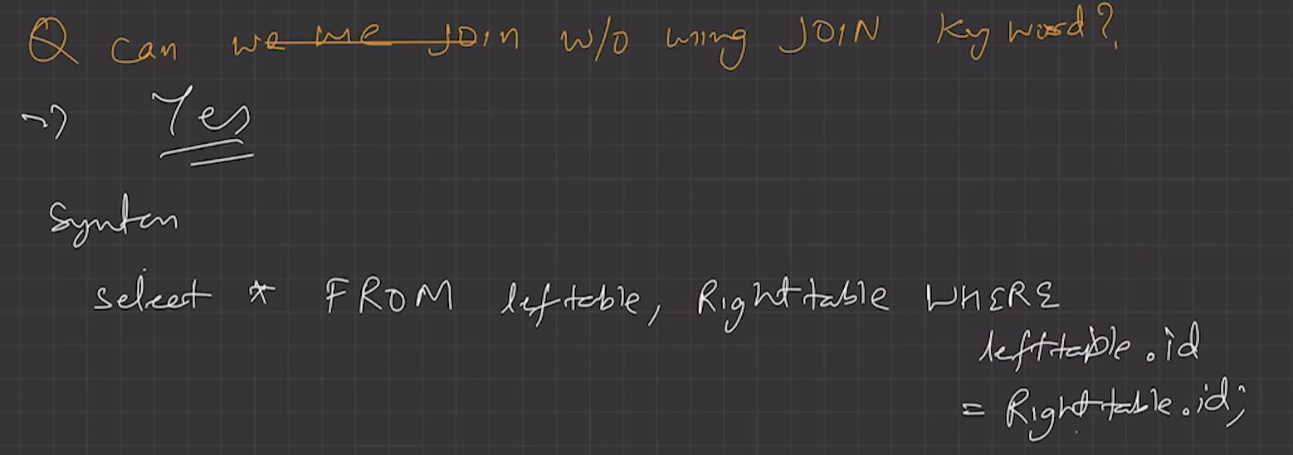
INNER JOINS ALTERNATIVE

Slide 48
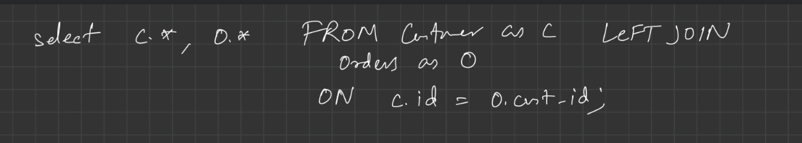
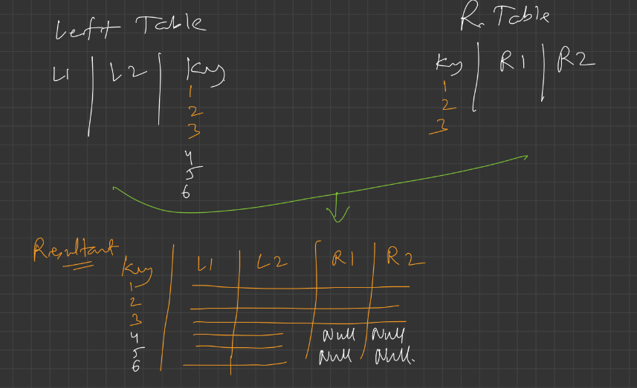
Left join
This returns all data from the left table but returns null values for the right table if data does not exist.
First returns matching and then rest of data

Slide 49
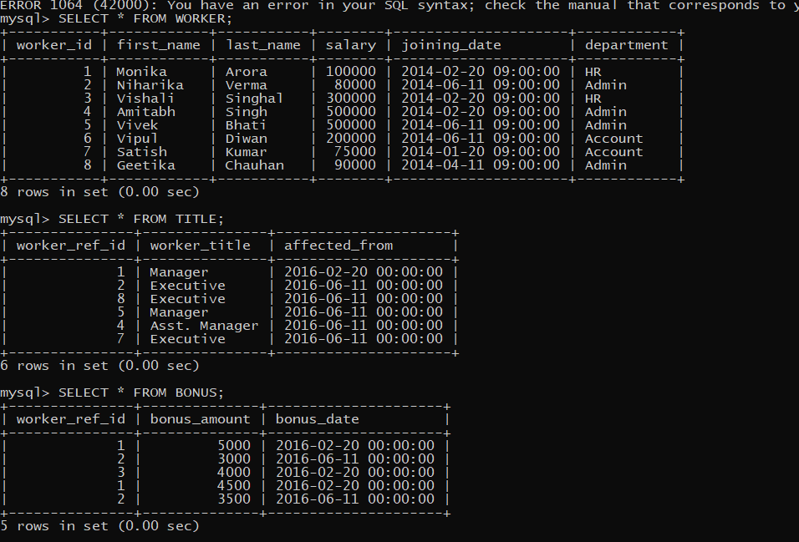

Slide 50
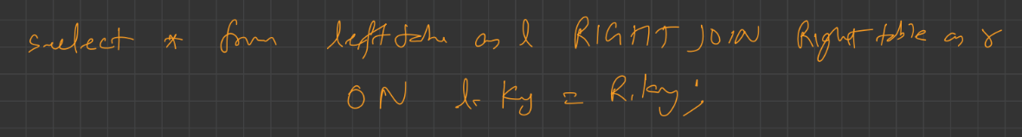

RIGHT join
This returns all data from the right table but returns null values for the left table if data does not exist.
First returns matching and then rest of data

Slide 51

FULL JOIN
This returns all data from the right table but returns null values for the left table if data does not exist. AND also returns all data from the left table but returns null values for the right table if data does not exist.
UNION OF LEFT AND RIGHT JOIN
NO KEYWORD LIKE: FULL JOIN

Slide 52




Slide 53


Slide 54



Slide 55

SELF-JOIN: it is a join which is not have any relation with any table, in fact it is a relation with itself.

Slide 56
A self-join allows you to connect a table to itself; it helps compare rows inside the same database or search hierarchical data.
Applications of Self Joins
Common scenarios where self-joins can be helpful:
Managing hierarchical data: Self-joins represent hierarchical relationships, such as organizational charts, product categories, or file systems. By joining a table to itself, you can retrieve parent-child relationships and navigate through the hierarchy.
Employee-Manager relationships: In an employee database, self-joins be used to retrieve information about employees and their managers. By comparing the employee ID with the manager ID within the same table, you can identify the reporting structure and gather details about managers and their subordinates.
Network analysis: Self-joins can be employed in network analysis scenarios. For example, if you have a table representing connections between users in a social network, a self-join can help identify common connections, mutual friends, or indirect relationships between users like on Facebook and Instagram.
Comparing related records: Self-joins also enable the comparison of related records within a table. For example, you can compare sales records of customers with the same postal code or find customers who have made multiple purchases over a specific period.

Slide 57

LIMIT
The LIMIT clause is used to specify the number of records to return.

Slide 58

Use of offset ➔ skip

Slide 59

When using limit with just a parameter : No of records to be fetched.
When using limit with 2 parameter : first is acting as a offset and the second parameter act as no of records to fetched .

Slide 60

SELECT * FROM Employee tb1 WHERE N-1 = (SELECT COUNT(DISTINCT salary) FROM Employee tb2 WHERE tb2.salary > tb1.salary)

Slide 61

SELECT * FROM Employee tb1 WHERE N-1 = (SELECT COUNT(DISTINCT salary) FROM Employee tb2 WHERE tb2.salary > tb1.salary)

Slide 62
SET OPERATIONS (UNION, INTERSECTION, MINUS)
Set operation always provide distinct records .
UNION : SHOULD BE APPLIED, BOTH THE TABLE MUST HAVE THE SAME NO. OF COLUMNS .

Slide 63


Slide 64


Slide 65


Slide 66



Slide 67


Slide 68



Slide 69


Slide 70


Slide 71
CREATE TABLE EMPLOYEE (id int primary key , fname varchar(225), lname varchar(225), age int ,emailId varchar(255), phoneNo int , city varchar(255));
CREATE TABLE CLIENT (id int primary key , first_name varchar(255),last_name varchar(255), age int, emailId varchar(255), phoneNo int , city varchar(255), empId int ,foreign key(empId) references employee(id));
CREATE table project(id int primary key , empId int , name varchar(255), startDate date, clientId int , foreign key(empId) references employee(id), foreign key(clientId) references client(id) );

Slide 72

alter table client modify column id int auto_increment; //add auto increment constaints
No need to provide id all the time .

Slide 73



Slide 74



Slide 75



Slide 76


Slide 77


Slide 78

SINGLE UPDATE
UPDATE EMPLOYEE e SET e.DEPARTMENT='DEPOSIT' WHERE FIRST_NAME='ALEX';
MULTIPLE UPDATE

Slide 79
Find Different type of departments in database
SELECT DISTINCT DEPARTMENT FROM EMPLOYEE ;
Display records with High-low salary
SELECT e.SALARY FROM EMPLOYEE e ORDER BY e.salary DESC;
How to see only top 3 records from a table SELECT * FROM EMPLOYEE LIMIT 3;
Show records where first name start with letter 'A'
SELECT * FROM EMPLOYEE e where e.FIRST_NAME like "A%";
Show records where length of the lname is 4 characters
SELECT * FROM EMPLOYEE e where length(e.LAST_NAME)=4

